Slide 1

National Police and Crime Measures
(Priorities for Policing)
Contribution of Avon and Somerset Police
Quarter ending November 2021

Slide 2
Glossary
Action Fraud – is the UK’s national reporting centre for fraud and cybercrime where victims should report fraud if they have been scammed, defrauded or experienced cyber crime in England, Wales and Northern Ireland.
ASP – Avon and Somerset Police
Cyber dependent crime – these are offences that can only be committed using a computer, computer networks or other form of information communications technology.
CPS – Crown Prosecution Service.
Domestic abuse – is where a person is abusive towards another, they are personally connected and are 16 years of age or older.
MSG – Most similar groups. These are groups of police force areas that have been found to be the most similar to each other based on an analysis of demographic, social and economic characteristics which relate to crime. They are designated by Her Majesty’s Inspectorate of Constabulary Fire & Rescue Service (HMICFRS). The forces ‘most similar’ to Avon & Somerset are Staffordshire, Derbyshire, Essex, Hampshire, Hertfordshire, Kent and Sussex. Most similar forces.
Neighbourhood Crime – defined in the national Beating Crime Plan 2021 as vehicle-related theft, domestic burglary, theft from the person and robbery of personal property.
Patrol – the department of Avon and Somerset Police which has most uniformed officers; these officers attend more incidents than any other department.
PREVENT – is a government-led programme which aims to safeguard vulnerable people from being drawn into terrorism.
Project Bluestone – is the Avon and Somerset Police response to Rape and Serious Sexual Offences. A transformative pathfinder approach being rolled out nationally as part of the cross-governmental improvement plan Operation Soteria.

Slide 3
Reduce Murder and Other Homicide
Measures Summary
Local Measures | Trend / Outlook | Benchmark
Police recorded Homicide offences | Stable | 3rd/8 MSG (below MSG average rates)
Planned Action to Drive Performance
Co-ordinated high intensity policing activity in serious violence hotspots, across the ASP force area, utilising Home Office Grip funding. (Grip funding will support intelligence and analytical capacity, to better identify serious violence hotspots and develop problem-solving approaches for those most at risk of violence). Enhancement of the existing response policing model to ensure that Patrol resources are deployed more effectively across the ASP force area; thereby ensuring that incoming emergency demand is appropriately serviced.
Comments
There are very low levels of recorded homicide within the ASP force area. ASP have comparatively lower rates of homicide compared to our most similar group (MSG) forces.

Slide 4
Reduce Serious Violence
Measures Summary
Local Measures | Trend / Outlook | Benchmark
Police recorded Serious Violence offences | Stable | 3rd/8 MSG (below MSG average rates)
Planned Action to Drive Performance
Co-ordinated high intensity policing activity in serious violence hotspots, across the ASP force area, utilising Home Office Grip funding. (Grip funding will support intelligence and analytical capacity to better identify serious violence hotspots and develop problem-solving approaches for those most at risk of violence). Enhancement of the existing response policing model to ensure that Patrol resources are deployed more effectively across the ASP force area; thereby ensuring that incoming emergency demand is appropriately serviced. Enhancement of the Investigations Directorate structure, to ensure that serious violence demand is appropriately allocated to and managed by specialist investigators. The pursuit and prosecution of offenders of serious violence will reduce the likelihood of repeat offending. Participation in Operation Sceptre, with the aim of reducing the number of people carrying knives through targeted operational activity, and by engagement with young people surrounding the consequences of knife crime.
Comments
The outlook for serious violence remains stable as we exit the COVID-19 pandemic and restrictions. ASP benchmark well against our MSG group of forces, based on rates of serious violence per 1000 residents. As part of a national data quality programme, the force have recently been increasing the accuracy of the way that knife crime is flagged and recorded.

Slide 5
Disrupt Drugs Supply and County Lines
Measures Summary
Local Measures | Trend / Outlook | Benchmark
Number of all drugs disruptions | Stable | Not available
Number of county lines disrupted | Stable | Not available
Number of drug trafficking offences | Reducing | 8th/8 MSG (below MSG average rates)
Planned Action to Drive Performance
Co-ordinated high intensity activity, involving cross-border policing resources, to proactively disrupt multiple county lines operating across ASP. Enhancement of the existing proactive capability within Remedy, to ensure that drugs supply and county lines within ASP is effectively disrupted. This will include an increase in policing capacity through police officer uplift. Continued proactive policing activity in the way that adults, who are at risk of exploitation through county lines criminality, are identified and safeguarded.
Comments
The force has a lower rate of drug trafficking offences per 1000 residents, compared to our MSG forces and this gap has been growing since mid 2020. The reason for this difference is being explored. It could indicate less offending but it could also indicate less proactive identification of the offending or something else in between.

Slide 6
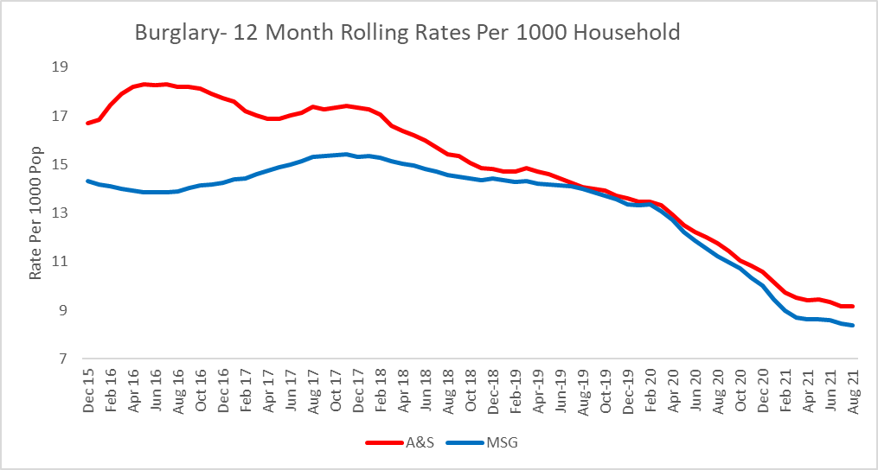
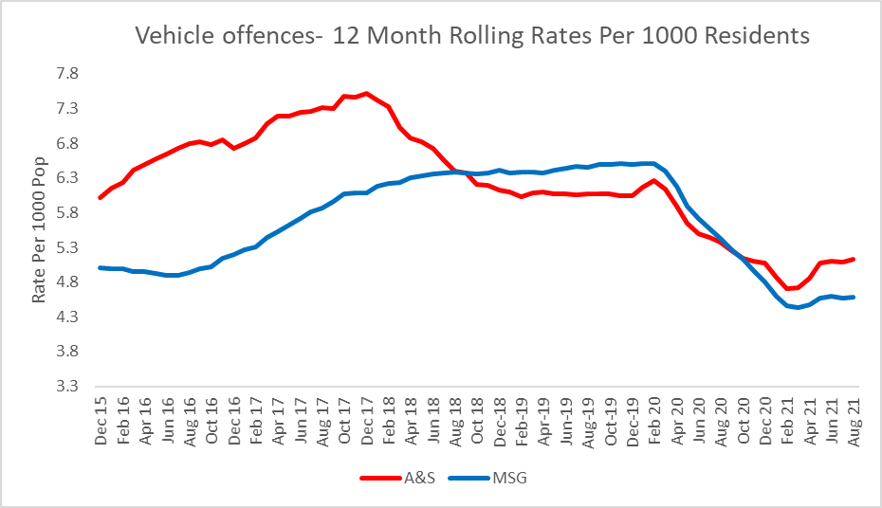
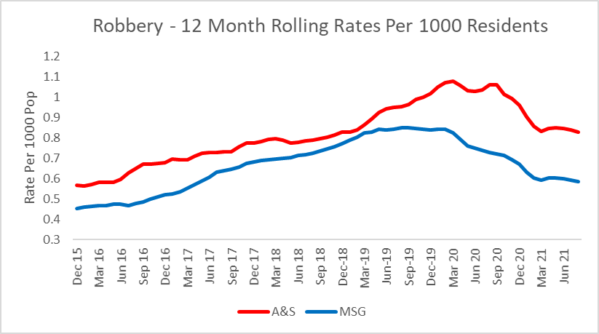
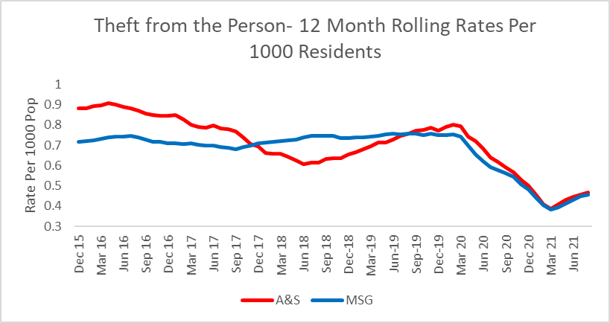
Reduce Neighbourhood Crime
Measures Summary
Local Measures | Trend / Outlook | Benchmark
Police recorded burglary offences | Moderate Reduction | 6th/8 MSG (Similar to MSG average rates)
Police recorded vehicle crime offences | Stable | 6th/8 MSG (Similar to MSG average rates)
Police recorded robbery offences | Stable | 8th/8 MSG (higher than MSG average rates)
Police recorded theft From the person offences | Stable | 5th/8 MSG (Similar to MSG average rates)
Planned Action to Drive Performance
Investigation of linked residential burglary series by the force proactive team; thereby ensuring offenders are brought to justice, and reducing the impact that burglary has upon the community. Focussed improvement in investigative standards, across all policing functions, supported by the development of a new guidance template for supervisors in completing crimes reviews; thereby improving the quality of investigations and increasing positive outcomes for neighbourhood crime. The pursuit and prosecution of offenders will reduce the likelihood of repeat offending. Enhancement of the existing response policing model to ensure that Patrol resources are deployed more effectively across the ASP force area; thereby ensuring that incoming emergency demand is appropriately serviced.
Comments
Recorded neighbourhood crimes were impacted significantly during the COVID-19 lockdown periods, and as a result saw large reductions. Crimes are anticipated to return to normal levels and therefore the outlook is based on ‘pre-COVID-19’ trends. Business robbery rates are three times greater than our MSG force average. ASP have conducted recent assurance activity in this field, and believe that the comparative increase is due to a high level of crime recording compliance in this area.

Slide 7
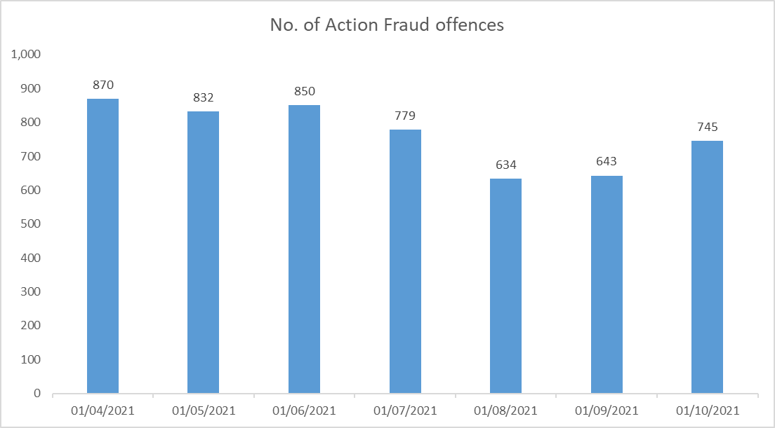
Tackle Cyber Crime
Measures Summary
Local Measures | Trend / Outlook | Benchmark
Investigate 100% of all cyber dependant crime disseminated to forces | Stable (100%) | Not available
Provide 100% of all cyber dependant crime victims with specialist advice | Stable (100%) | Not available
Action Fraud Offences | Stable | Not available
Planned Action to Drive Performance
Promotion of fraud-awareness, linking to national campaigns, to increase public understanding of offending methods and to deliver appropriate crime prevention advice.
Comments
There is no local measurement similar to the national measures, which focus on ‘Confidence in the law enforcement response to cyber crime’ and ‘the percentage of businesses experiencing a cyber breach or attack’. Both of these measures are captured at a national level.

Slide 8
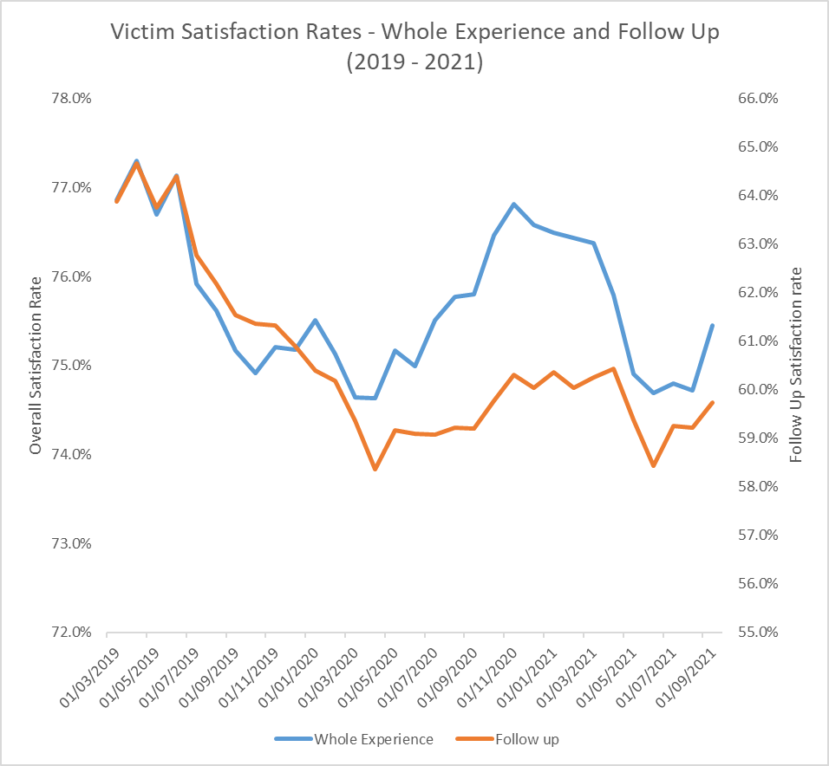
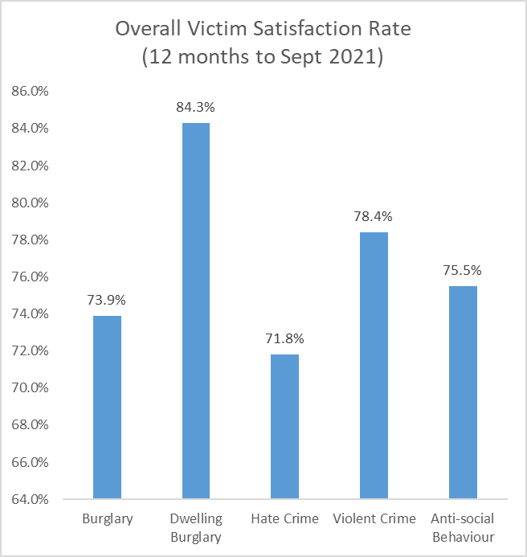
Improve Victim Satisfaction, with a Focus on Victims of Domestic Abuse
Measures Summary
Local Measures | Trend / Outlook | Benchmark
Overall victim satisfaction rate | Stable | Not available
Hate crime victim satisfaction rate | Small reduction | Not available
Violent crime victim satisfaction | Stable | Not available
Burglary victim satisfaction | Stable | Not available
Planned Action to Drive Performance
Delivery of Project Bluestone, and the implementation of specialist teams dedicated to the investigation of rape and serious sexual offences (RASSO). This will clearly support victims of domestic abuse-related RASSO. Focused activity, by all investigators in ASP, to complete an online training package covering relevant areas of the Victims Code of Practice. Focused activity, by all investigators in ASP, to increase compliance with the Victim's Code of Practice, through the delivery of mandatory investigative updates for victims of crime. Delivery of refresher training for all officers and staff in the Detainee Investigation Team, surrounding the criteria for and assurance of Domestic Violence Protection Orders, that provide protection for victims of domestic violence. Development of an improved way of working within the Incident Assessment Unit to ensure that, wherever additional victim-based crimes are identified, they are correctly recorded at the earliest opportunity.
Comments
Overall victim satisfaction is stable in ASP. Dwelling burglary victim satisfaction remains strong in ASP. There is currently no robust domestic abuse victim satisfaction survey currently in place, due to the clear challenges in dealing with sensitive and vulnerable victims.

Slide 9
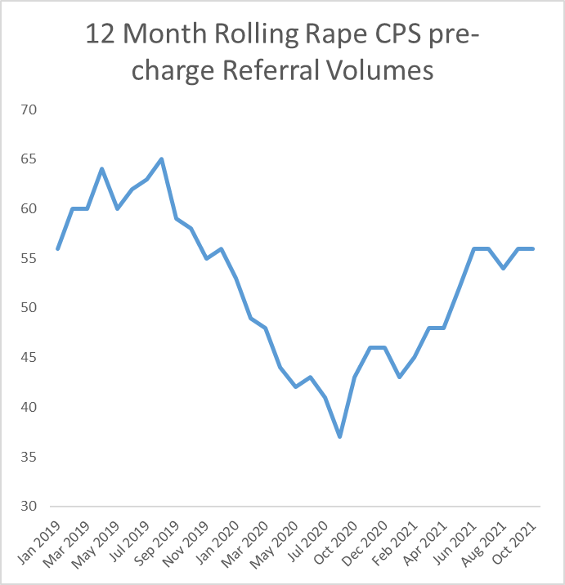
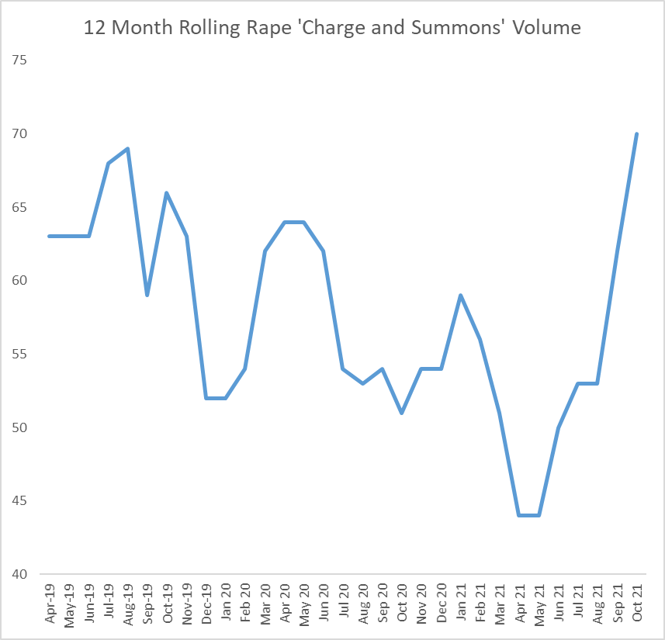
Better Criminal Justice Outcomes for Rape Cases
Measures Summary
Local Measures | Trend / Outlook | Benchmark
Volume of Rape referrals to CPS | Moderate Increase | Not available
Charge volumes for Rape offences | Moderate Increase | Not available
Charge rate for Rape offences | Stable | 8th/8 MSG (below MSG average rates)
Planned Action to Drive Performance
Delivery of Project Bluestone, and the implementation of specialist teams dedicated to the investigation of rape and serious sexual offences (RASSO). (Project Bluestone proposed the development of a ‘gold standard’ framework for the investigation of RASSO, using specialist investigators to enhance victim contact and disrupt persistent offenders). Development of an improved way of working within the Incident Assessment Unit to ensure that, wherever additional victim-based crimes (including RASSO) are identified, they are correctly recorded at the earliest opportunity.
Comments
There has been a clear recent increase in both CPS pre-charge rape-referrals and police charges.

